Slide 1
Digital Justice – A Step towards Digital Single Market?
Olga Sovova
Police Academy Of the Czech Republic in Prague

Slide 2

INTRODUCTION
Digitalisation in legal practice
Temporary phenomenon or significant and permanent change ?
Post -industrial society
Technologies
Knowledge management
Digital public services

Slide 3
DIGITAL SINGLE MARKET IN JUSTICE
Cooperation in legal matters
Set of formulas and information on national and EU laws
Entry into public company registries.
European Arrest Warrant
Public Prosecutor's Office
https://e-justice.europa.eu/

Slide 4
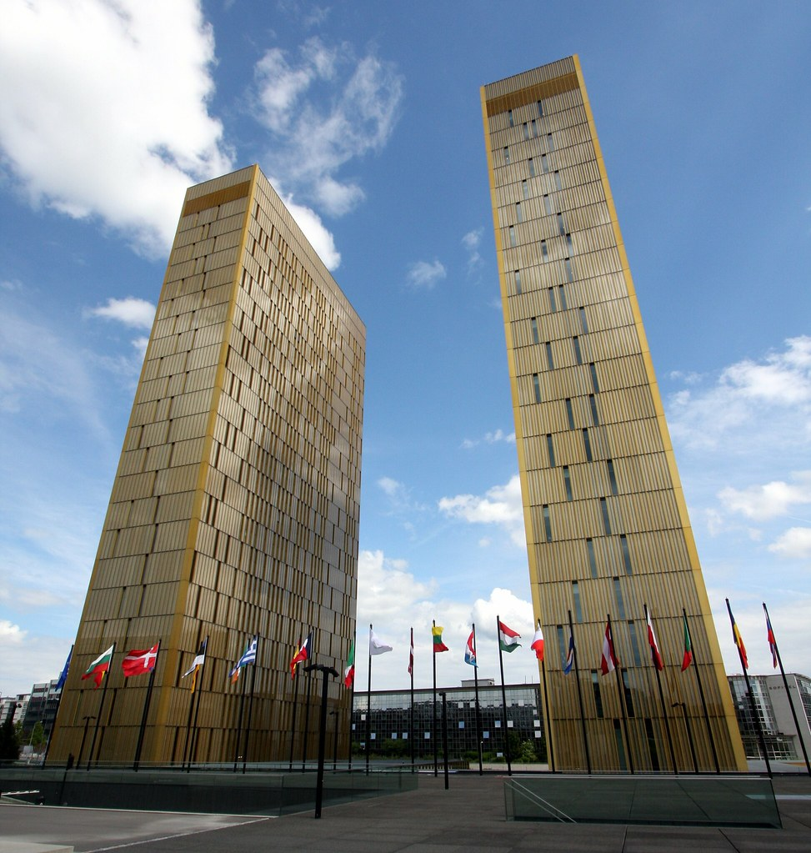
DIGITAL SINGLE MARKET IN JUSTICE
Tool to help reduce pandemics' impacts and economic crises
Post-crisis period needs
Interoperability across Europe in justice matters
Communication with the users and between judicial authorities online
Remote access and standardisation should be the first option for every participant and the public service
Europe's Digital Decade targets till 2030
https://www.consilium.europa.eu/en/policies/a-digital-future-for-europe/
Tato fotka od autora Neznámý autor s licencí CC BY-ND

Slide 5

DIGITAL LEGAL SERVICES
E-Justice cannot be limited just to the courts, state prosecution, probation or prison service or other public services administered by the Ministry of Justice
Material rule of law demands broad access and enforceability of laws.
Legal professions like attorneys, public notaries, and executors form part of legal services
Their roles in the judicial system differs
Tato fotka od autora Neznámý autor s licencí CC BY

Slide 6

Digital Legal Services
Benefits
Information and data sharing
Electronic files
Rational service delivery
Cloud computing
Online advisory
Remote access
Home office
Open justice
Risks
Personal data protection
Confidentiality duty
Applications operate independently
Law may lose regulation effect
Password sharing
Long court hearings
Constant online availability

Slide 7

Digital legal services
Czech Supreme Court underlined the significance of electronic files and cloud computing in connection with the confidentiality duty and the client-attorney privilege. "Premises in which a lawyer as any space that is related to the practice of advocacy and in which there is, therefore, information about clients whether in written, electronic or another form. "

Slide 8
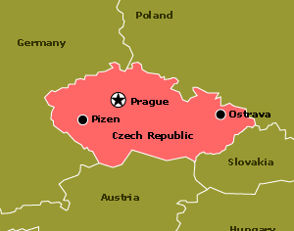
  LEGAL AND SOCIAL FRAMEWORK OF DIGITAL JUDICIARY IN THE CZECH REPUBLIC
Digitalisation and computerisation of the public sphere in the late 20th century
Tato fotka od autora Neznámý autor s licencí CC BY-SA

Slide 9
LEGAL AND SOCIAL FRAMEWORK OF DIGIT LEGAL AND SOCIAL FRAMEWORK OF DIGITAL JUDICIARY IN THE CZECH REPUBLIC
AL JUDICIARY IN THE CZECH REPUBLIC
Act on the Right to Digital Services, No. 12/2020, completed the delineation of digital public services
Each court enables access to the court officials via e-mail
Ectronic official board and court websites introduce information to the public and participants
The Constitutional Court, the Supreme Court and the Supreme Administrative Court publish their decisions on the electronic board. The mentioned high courts have English websites

Slide 10
LEGAL AND SOCIAL FRAMEWORK OF DIGITAL JUDICIARY IN THE CZECH REPUBLIC
Digitalisation of everyday justice remains in the testing phase
Only reliable information on the lower court's website is the date and hour of the proceedings
Databases of regional and district courts' rulings do not exist
The connectivity score is 52,7, which is relatively low compared to the EU average of 59, 9

Slide 11

Digital Economy and Society Index (DESI) 2022 – Results Czech Republic
https://digital-strategy.ec.europa.eu/en/library/digital-economy-and-society-index-desi-2022
Public servants have good digital skills. Human capital scores 45,6, just 0,1 points under the EU score
Connectivity score is 52,7, which is relatively low compared to the EU average of 59,9
In the integration of digital technology, the Czech Republic occupies the nineteenth place in the EU (score 36,1) with a score of 33,8,

Slide 12
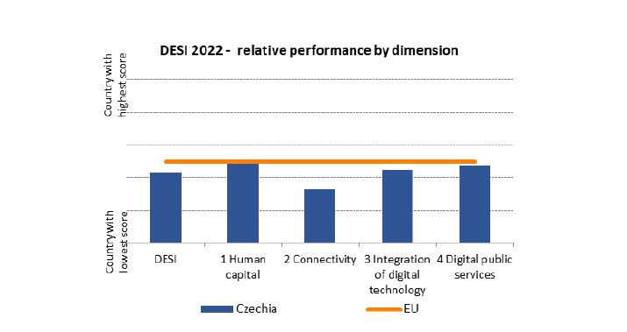

Slide 13

Conclusion
Global information society requires new legal, managerial, and practical approaches to the daily and long-term tasks of the judiciary
State administration, courts, legal advisors and public officers must move from the old part of lordly decision-making to the cooperative and supporting manager position
Tato fotka od autora Neznámý autor s licencí CC BY-SA

Slide 14

Conclusion
In 2018, the vice-president of the Supreme Court warned that even if the most significant perspective for a fast and efficient court procedure lies in its complete digitalisation, judging- deciding on human disputes, fates, guilts, and punishments should forever remain in the hands of people
Tato fotka od autora Neznámý autor s licencí CC BY-SA

Slide 15

Legal system and the rule of law belong to essential tools.
Digitalisation is the mean; the lawyer is the one who explains, advises, and acts
Tato fotka od autora Neznámý autor s licencí CC BY-SA

Slide 16


